Slide 1
Machine Learning
Morteza Maleki

Slide 2
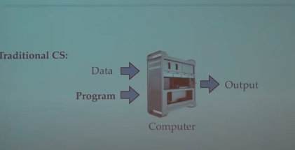

Slide 3
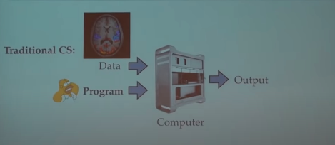

Slide 4
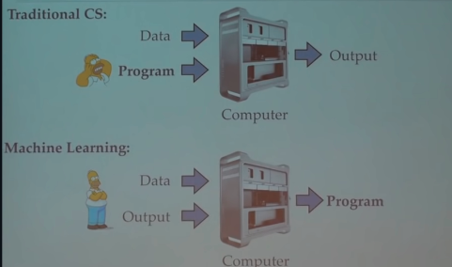

Slide 5
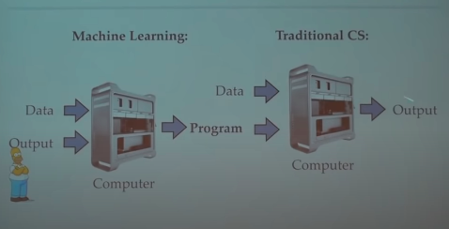

Slide 6
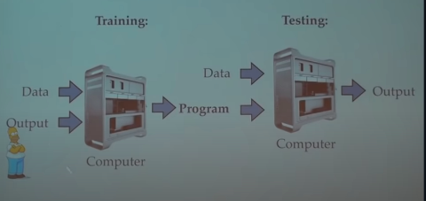

Slide 7
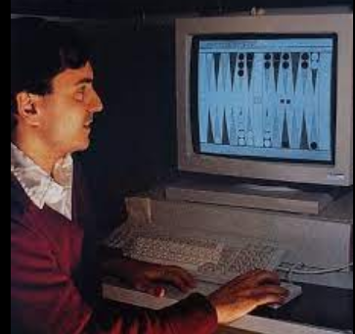
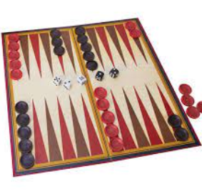
Gerrt Tesauri (IBM) teaches a
neural network to play
Backgammon.
100k games aginst itself
and beat world champion

Slide 8
در ابتدا می‌گفتن AI بعد به دلیل مشکلاتی که رخ داد با یک مساله ساده تبدیلش کردن به یادگیری ماشین
logic to probability

Slide 9
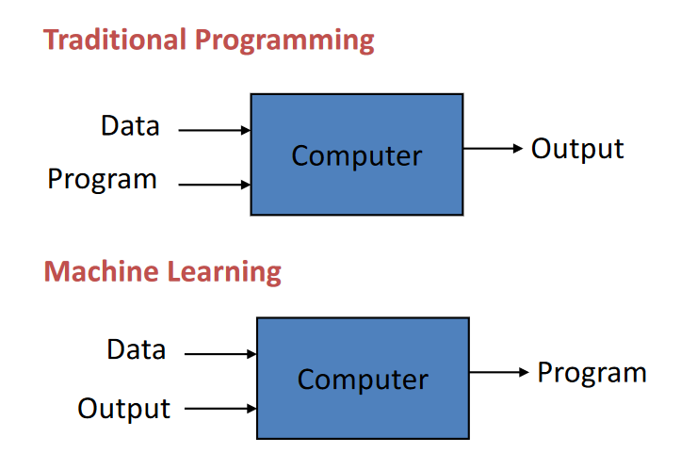


Slide 10
“Machine Learning: Field of study that gives
computers the ability to learn without being
explicitly programmed.” -Arthur Samuel (1959)

Slide 11


Slide 12
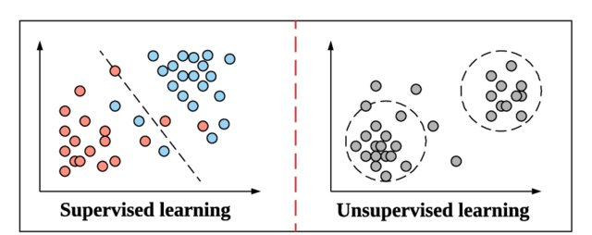

Slide 13
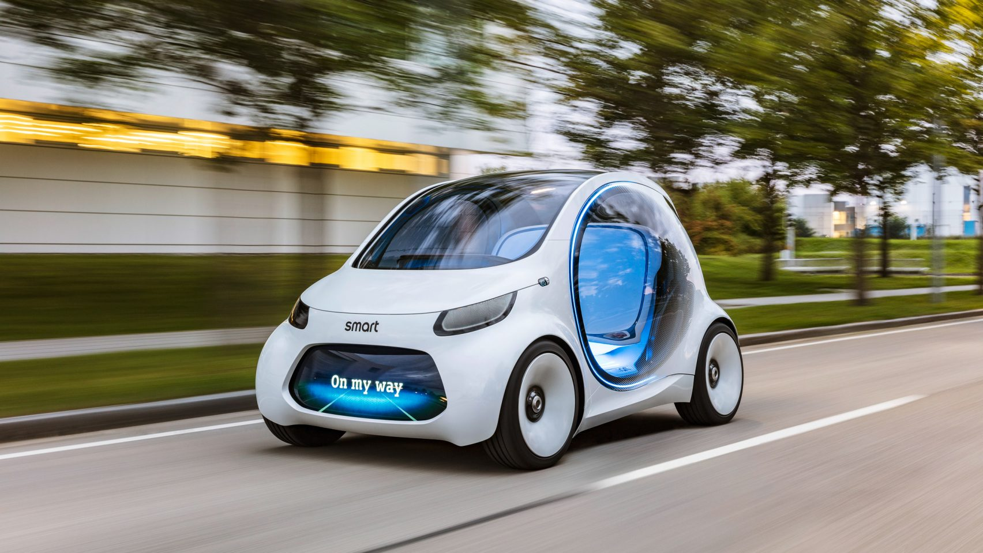
Self driving cars
RL

Slide 14
Compose in the style of Chopin starting with Mozart’s Rondo alla Turca
https://openai.com/blog/musenet/
GPT 2

Slide 15
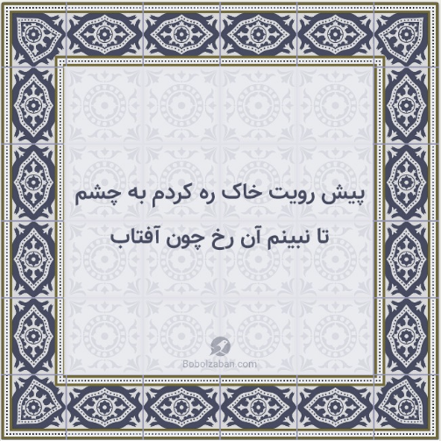
Persian one!
GPT2
Generative Pre-trained Transformer 2
http://www.bolbolzaban.com/about

Slide 16
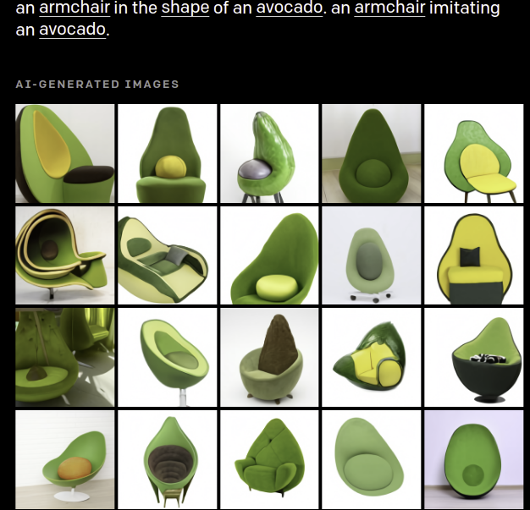
GPT3

Slide 17
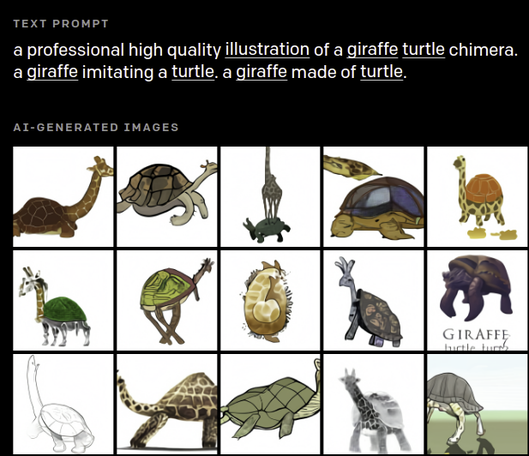
GPT3

Slide 18
Atlas robot can back flip

Slide 19
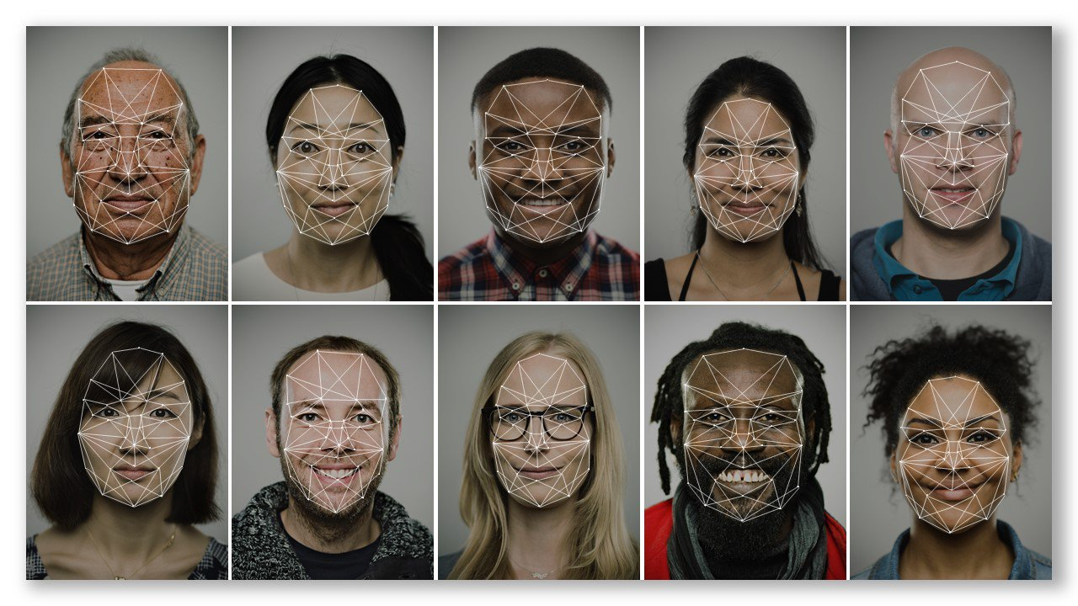
Face Recognition
CNN

Slide 20
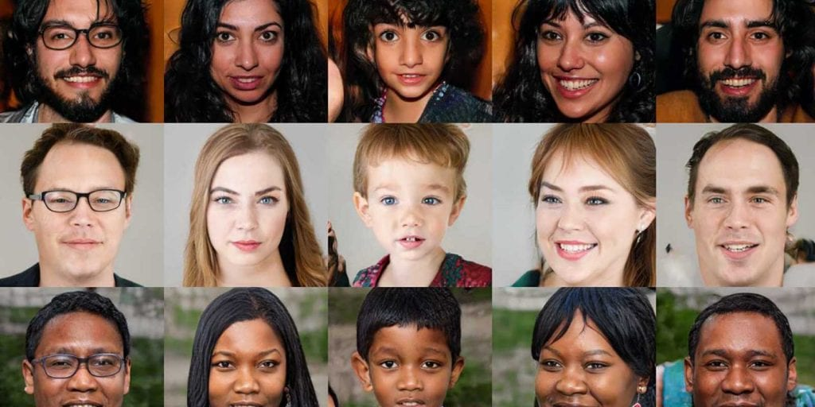
Generating images like real one!
Gan

Slide 21
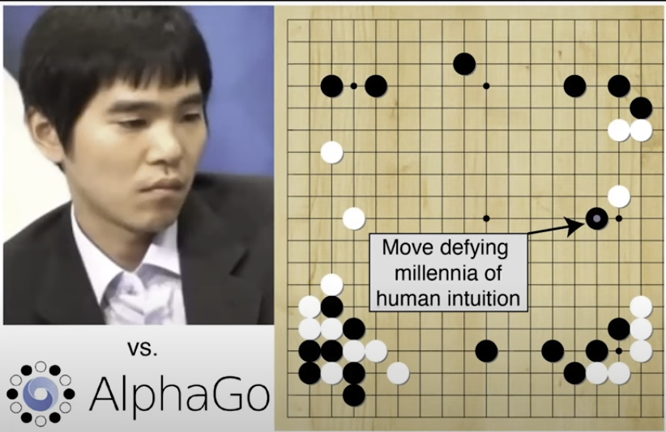
AlphaGo (Deepmind) VS Lee Sedol (South Korea )

Slide 22
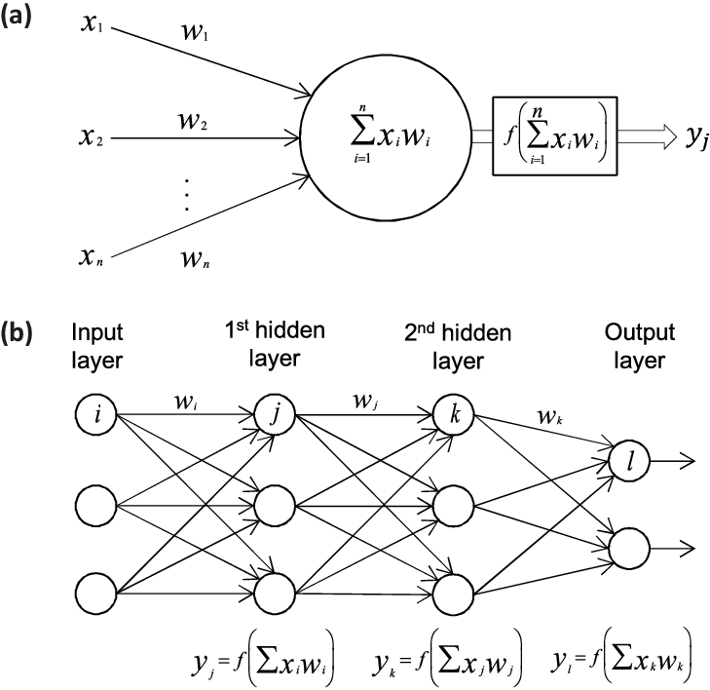
Neural Network Deep Learning

Slide 23
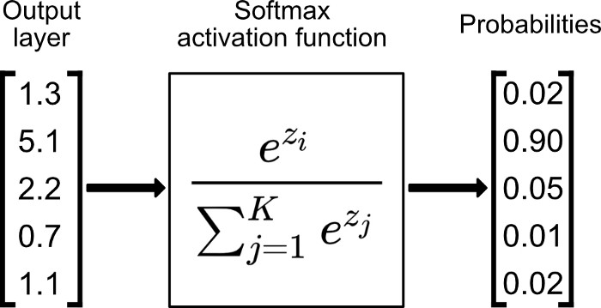
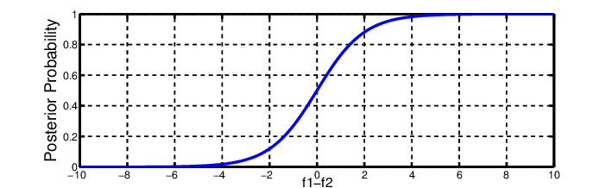
Deep Learning

Slide 24
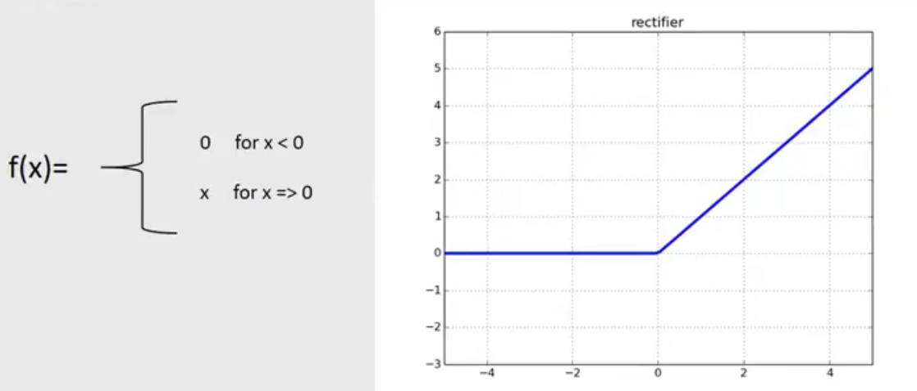
Deep Learning

Slide 25

Convolutional Neural Network

Slide 26

Convolutional Neural Network

Slide 27
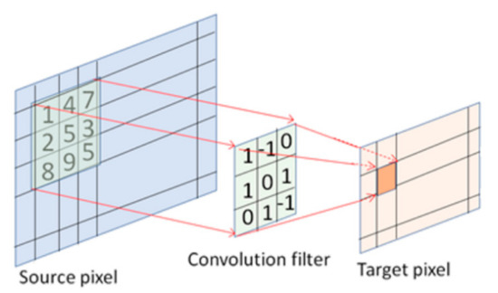
Convolutional Neural Network

Slide 28

Convolutional Neural Network

Slide 29
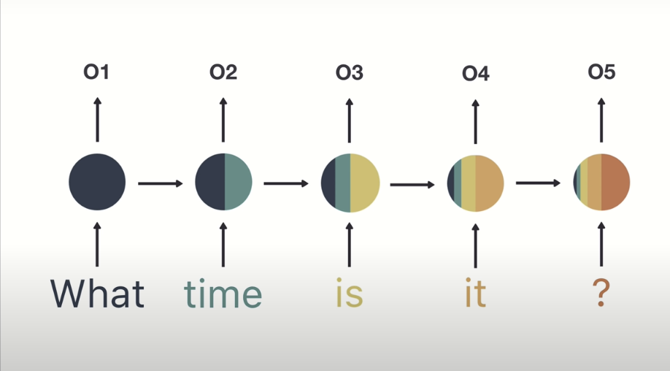
Recurrent neural networks(RNNs)

Slide 30
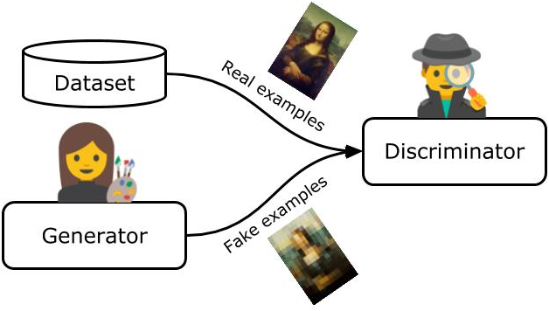
Generative Adversarial Network(GAN)

Slide 31
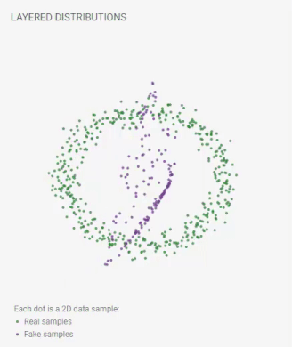
Generative Adversarial Network(GAN)

Slide 32
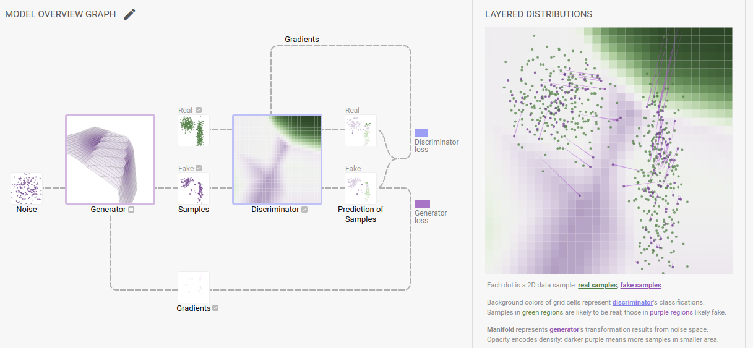
Generative Adversarial Network(GAN)

Slide 33
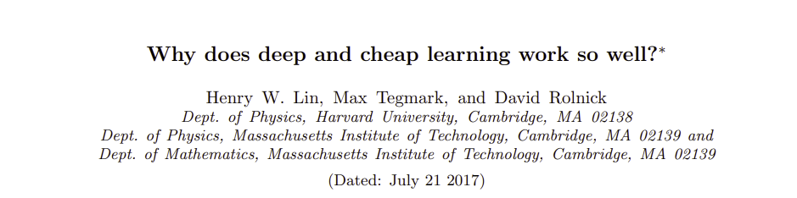
ML way of work? (maybe?!)

Slide 34
How to start??
How to start??
Is there a lot of probability and mathematics?
Do I need extraordinary programming skills?

Slide 35




How to start??
PYTHON

Slide 36
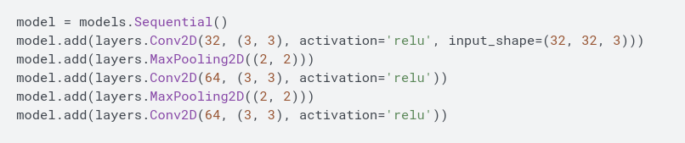
CNN tensorflow model example

